Slide 1

Automotive Inventory Management System

Slide 2
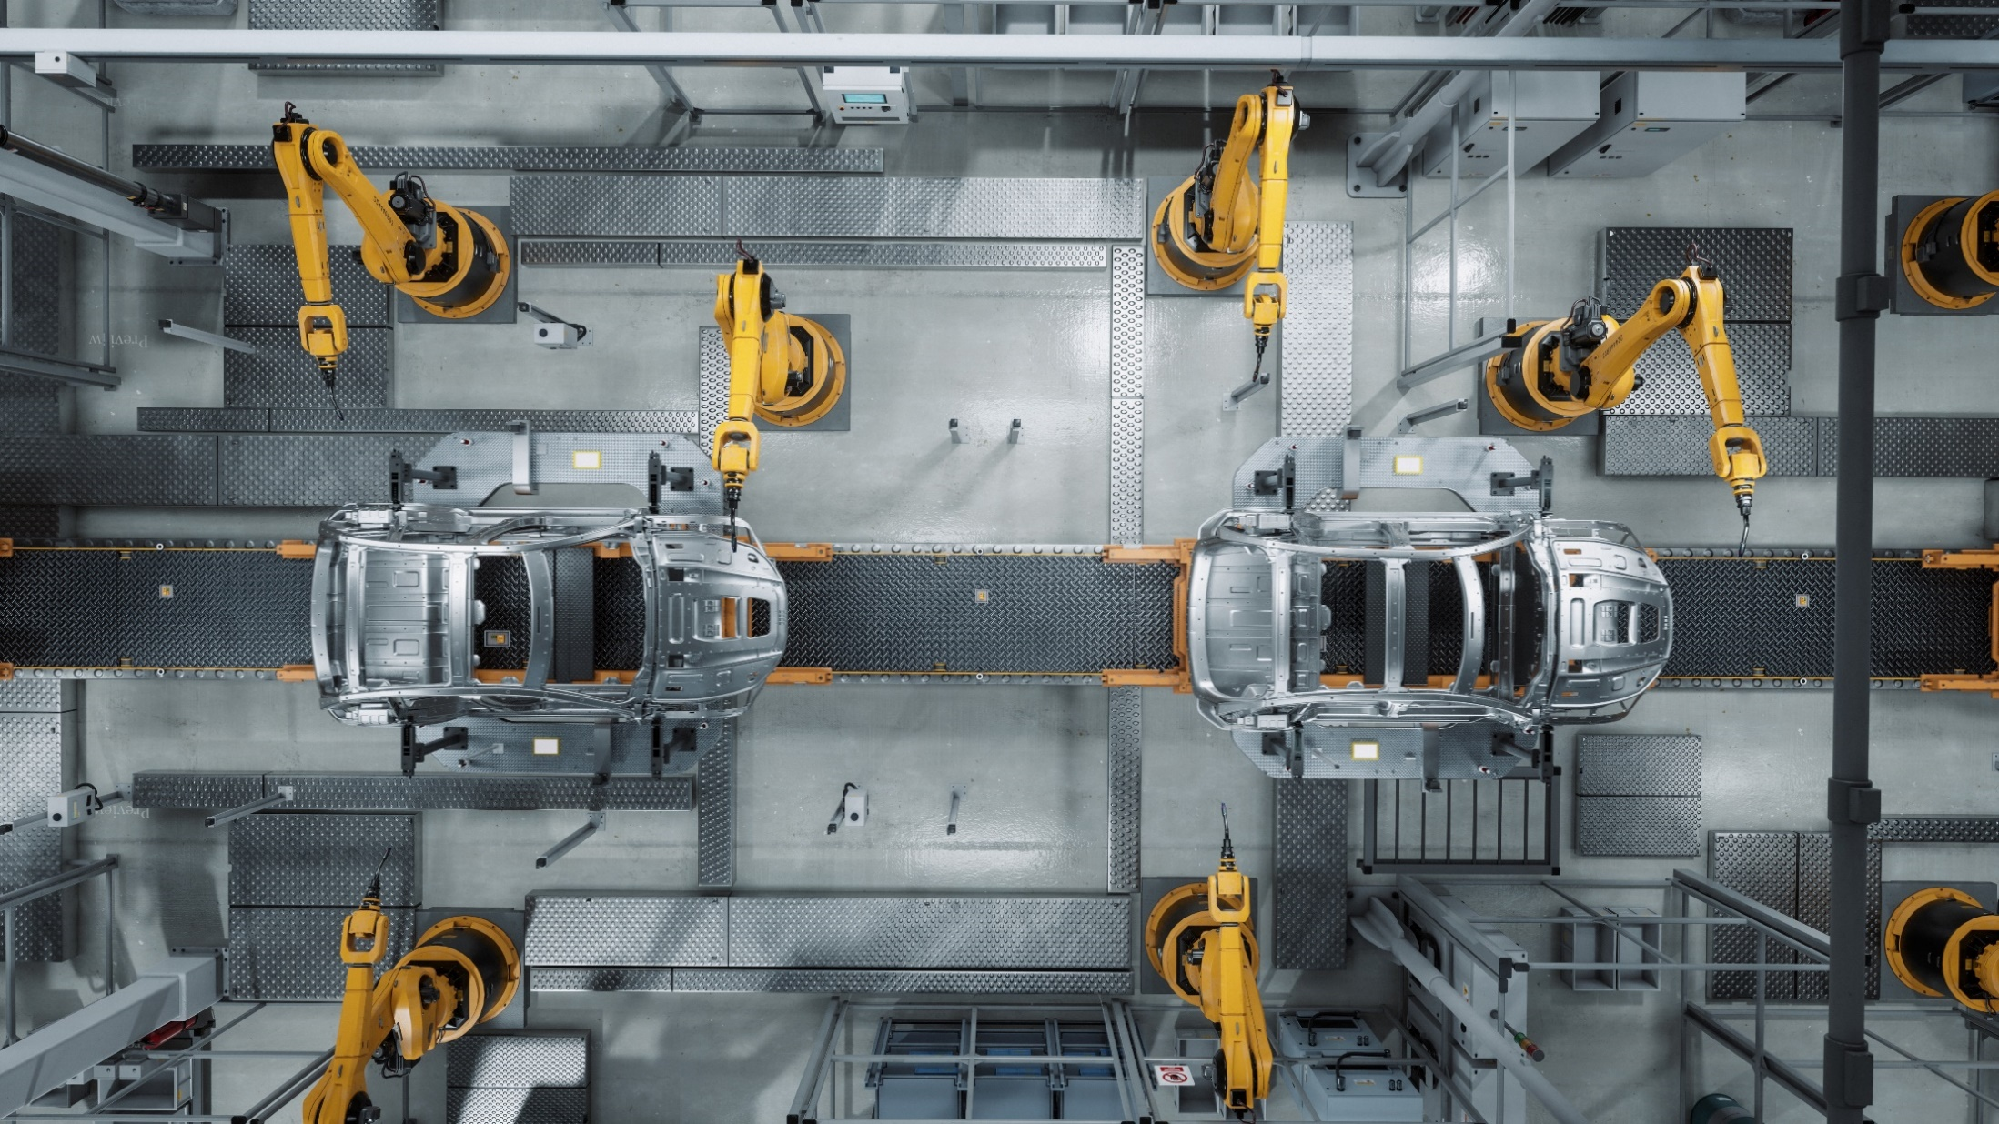



Our Team Members
SRUTHI
PRABA
ANUSHA

Slide 3

ABSTRACT
The Automotive Inventory Management System is developed to streamline stock management in the automotive industry.
It ensures real-time visibility of inventory across multiple plants and warehouses.
The system generates automated alerts for low stock and excess items.
Supplier performance is tracked to identify timely and quality partners.
Dashboards and reports support quick and informed decision-making. This solution reduces costs by optimizing stock levels and transfers.
Overall, it empowers management with data-driven insights for efficiency. The project integrates Oracle Database, SSIS, SSRS, and Power BI to deliver reporting and analytics.

Slide 4

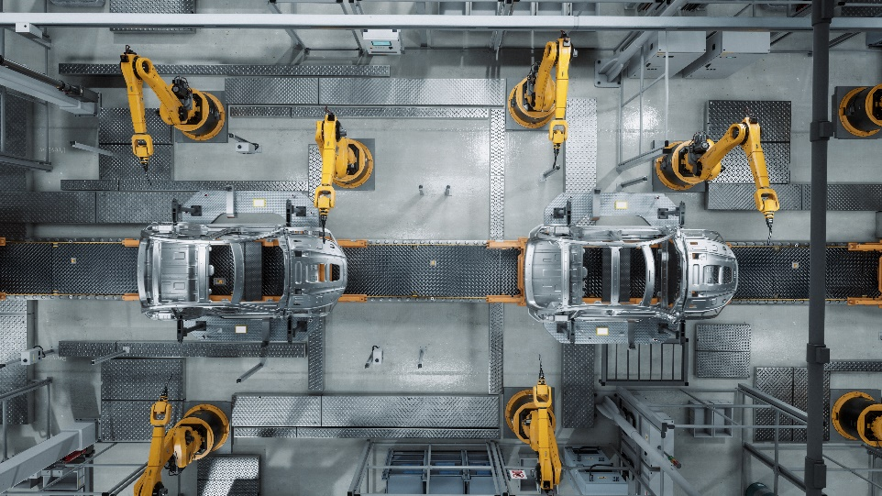
SYSTEM ARCHITECTURE:
• Database: Oracle
• ETL: SSIS for data integration
• Reporting: SSRS
• Dashboards: Power BI
• Security, audit, and automation features

Slide 5
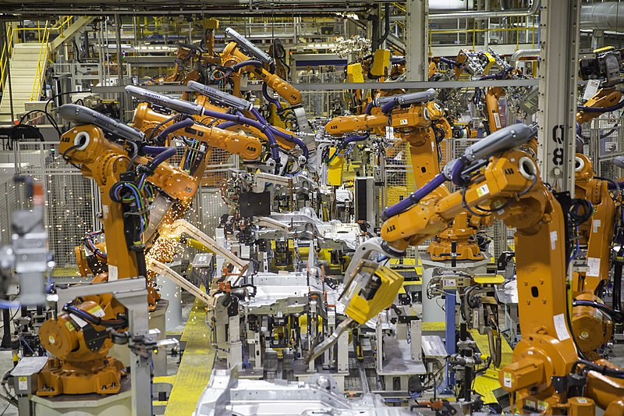
Use Case: Real-Time Inventory Management
Imagine running multiple plants in different countries.
Sometimes one plant is struggling with shortages, while another has piles of unused stock.
Before this project, managers had to rely on manual updates and phone calls, which often caused delays and mistakes.
With our system, inventory data from all plants is visible in one place, in real-time.
Managers instantly know what is running low, where stock is available, and what action to take.
Impact: No production stoppages, no overstock, and much smoother coordination between plants.

Slide 6
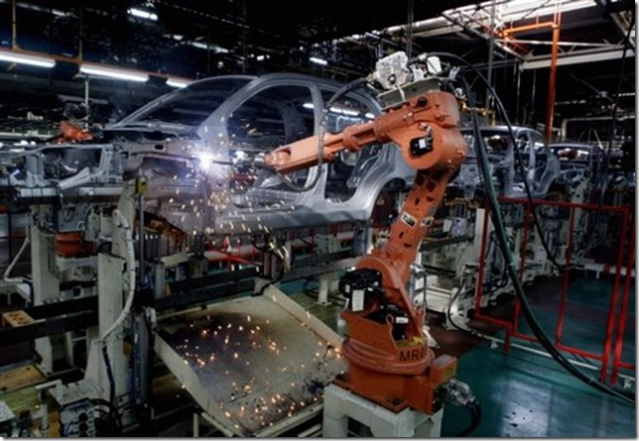
Use Case: Automated Alerts & Smart Decisions
In the old way of working, shortages were noticed only when it was too late—sometimes right when production was about to start.
Our project changes this: it constantly monitors stock levels and sends automatic alerts when items fall below a safe threshold.
Instead of just showing a problem, the system also suggests solutions:
Should we reorder from a supplier?
Or should we transfer stock from another plant that has extra?
This means managers don’t waste time searching for answers — the system guides their decisions.
Impact: Faster responses, fewer emergencies, and more confident planning.

Slide 7

Oracle Database Tables:
Store all key data like products, suppliers, inventory, transactions, and orders.
Act as the backbone of the system where everything is organized.
Benefits : Provides a central place for all inventory information. Ensures accuracy, consistency, and easy access to data.
Makes reporting and analysis reliable with a single source of truth. Scales easily as company data grows.

Slide 8
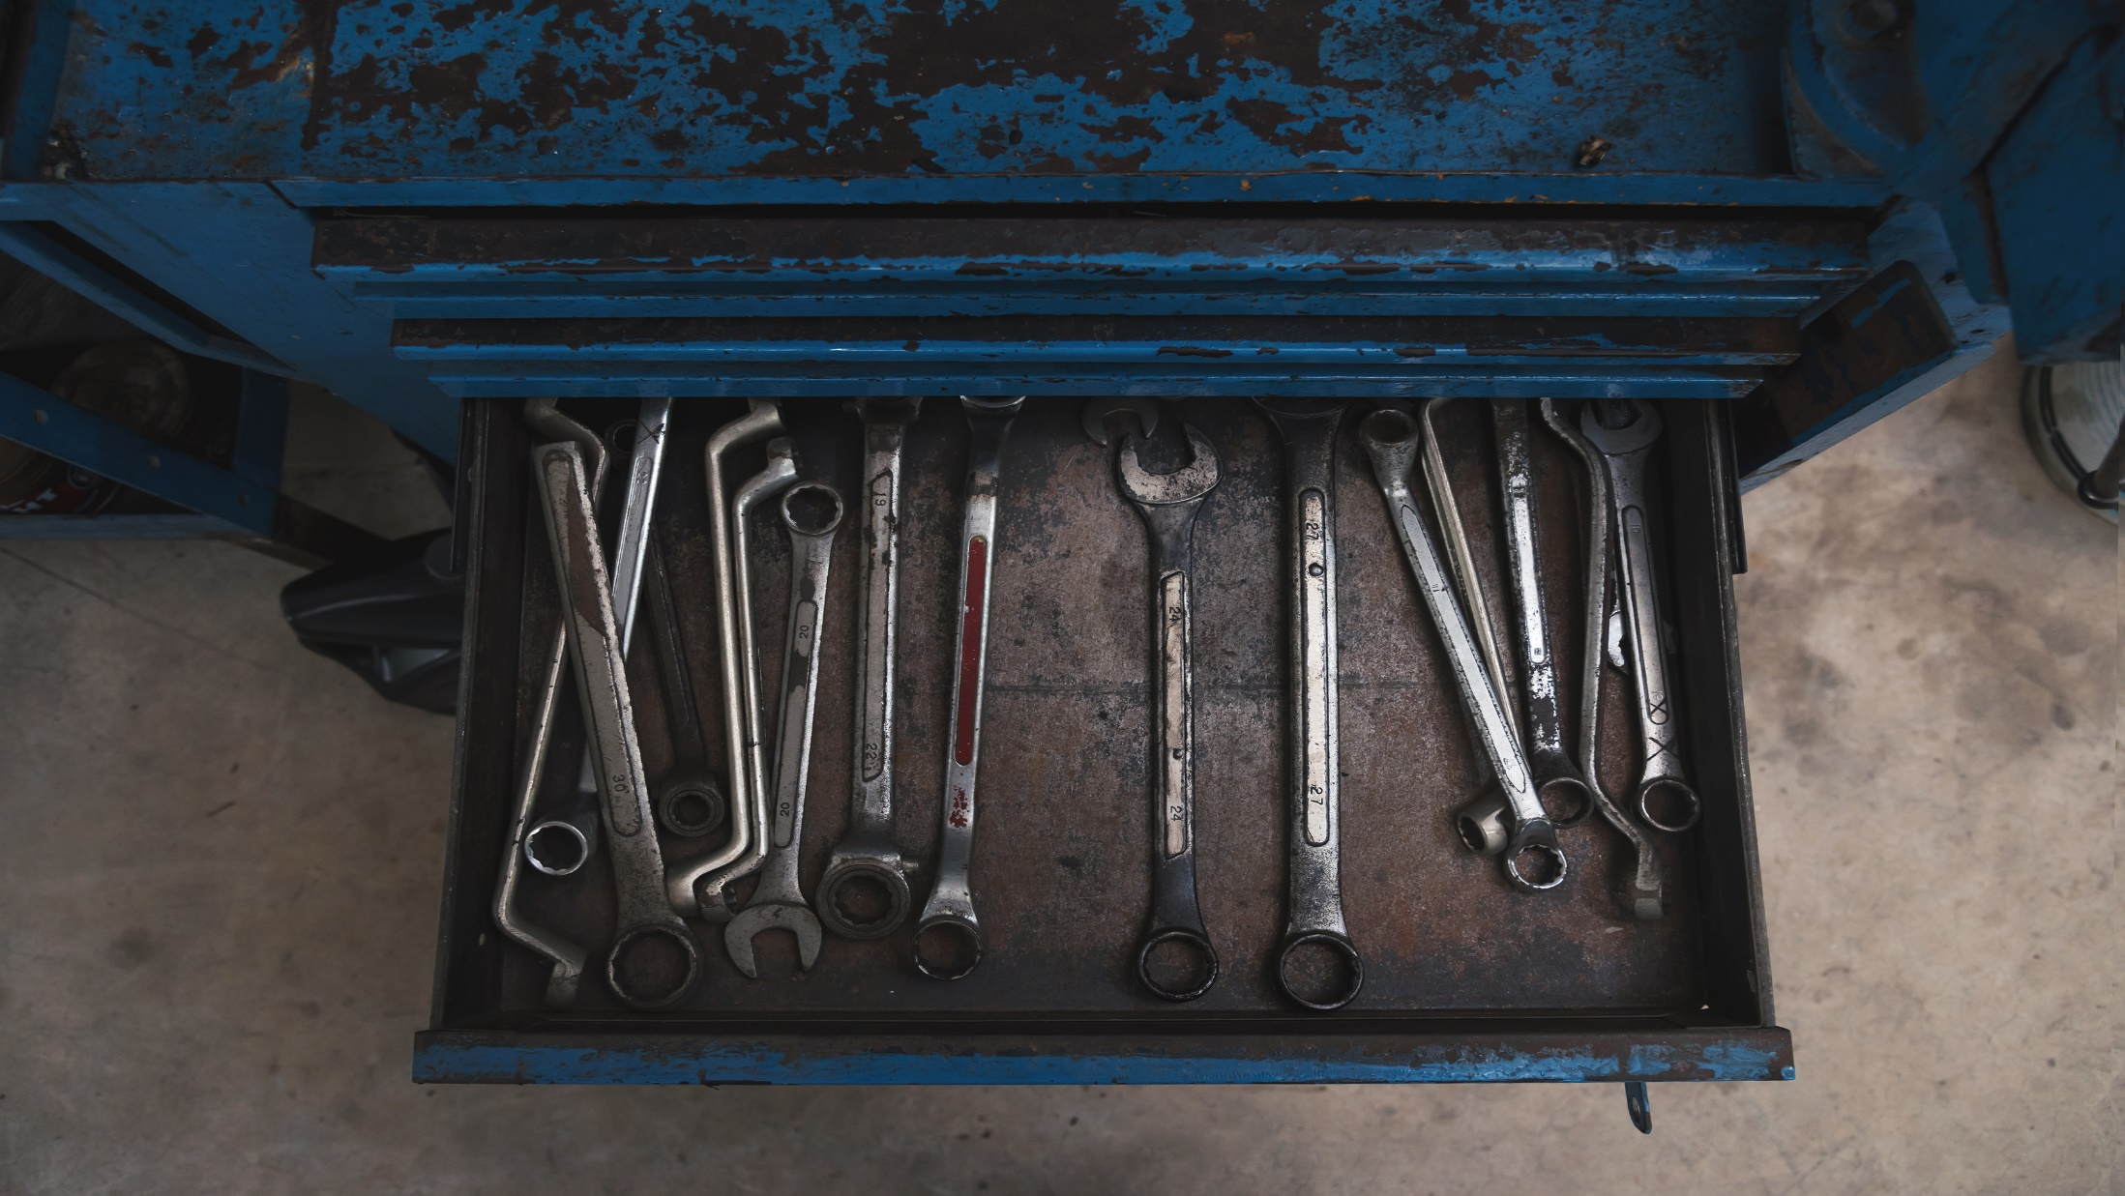
INFROMATION ABOUT DATASET
The dataset is composed of multiple files:
PRODUCTS : 200+ automotive parts
LOCATIONS : 5 international plants & R&D Centre
SUPPLIERS 25+ global suppliers
INVENTORY TRANSACTIONS : 2000+ records
PURCHASE ORDERS : 100+ records
SUPPLIER PERFORMANCE : 300+ records

Slide 9
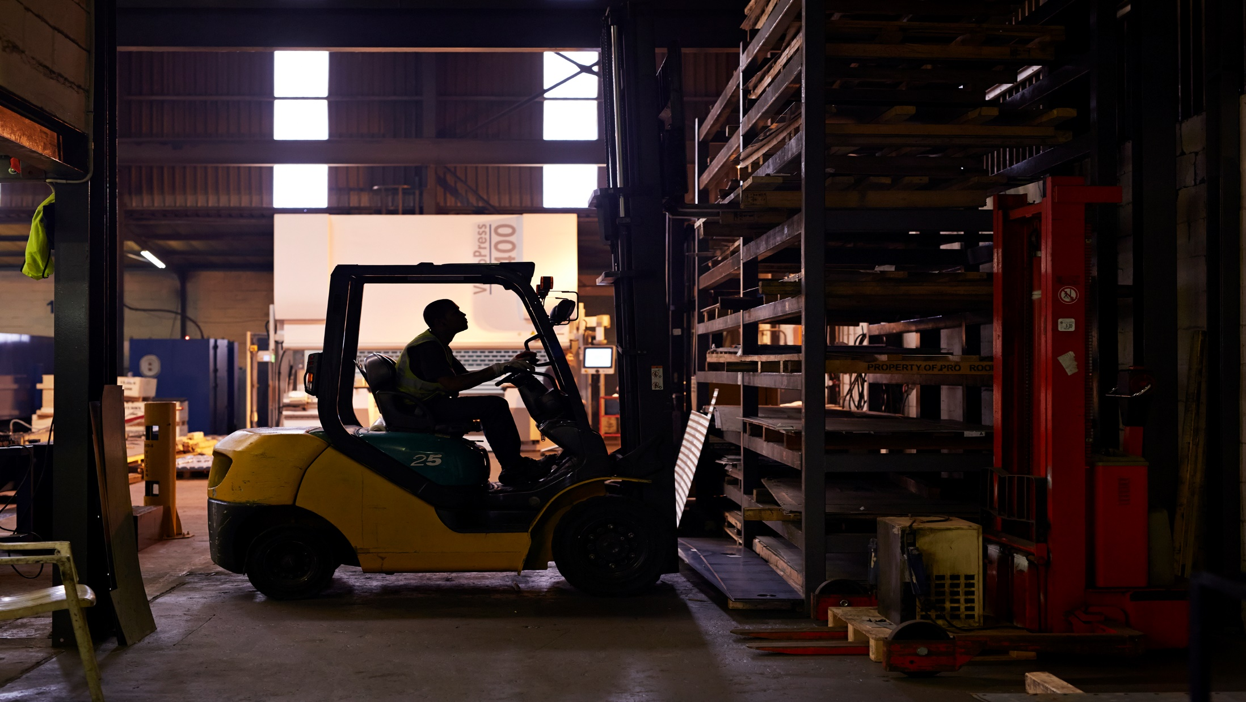
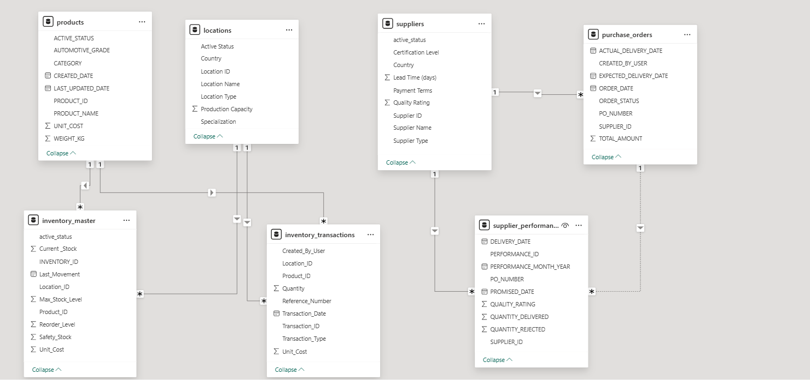
ER Diagram

Slide 10

PL/SQL Scripts:
Automate business logic inside the database.
Handle tasks like checking reorder levels, transferring stock, calculating supplier performance, validating data.
Benefits : Saves time by automating repetitive tasks.
Reduces human error with built-in rules and validations.
Improves efficiency by processing data quickly inside the DB.
Keeps the system consistent and reliable.

Slide 11

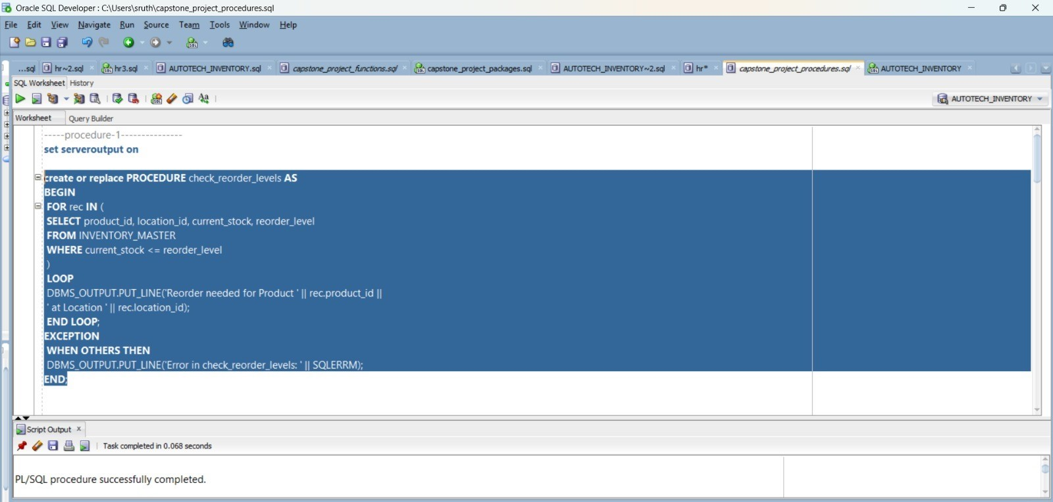
Reorder Level Monitoring in Inventory Management

Slide 12

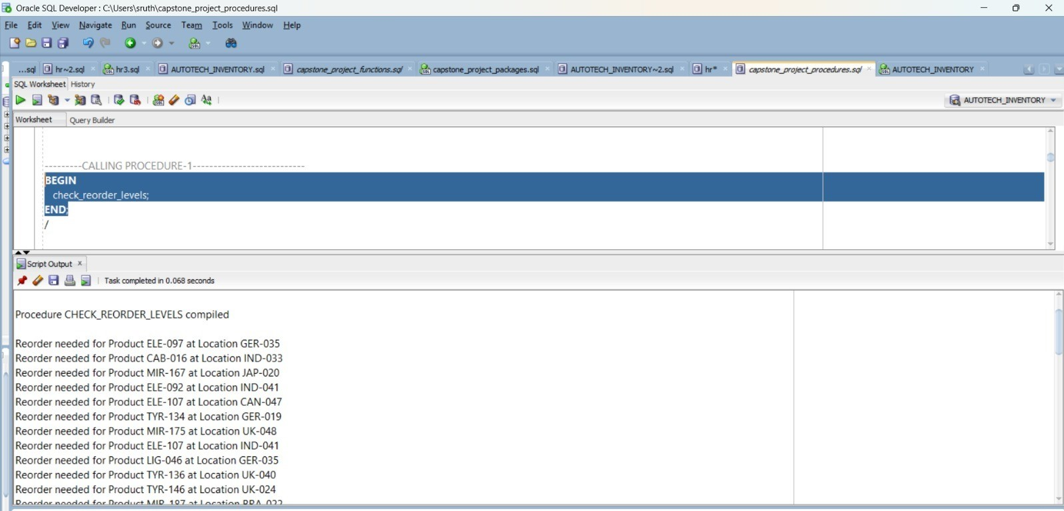
Executing the Reorder Check Procedure

Slide 13

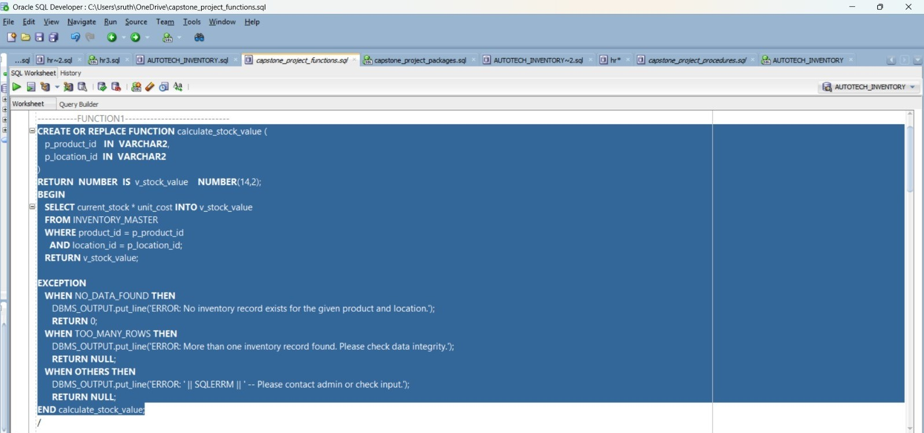
Function Implementation: Calculating Inventory Worth

Slide 14
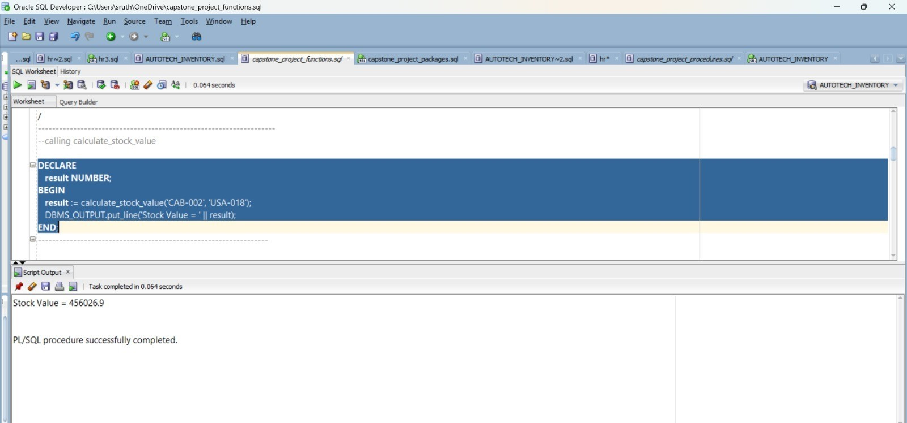
Executing the Stock Value Function

Slide 15

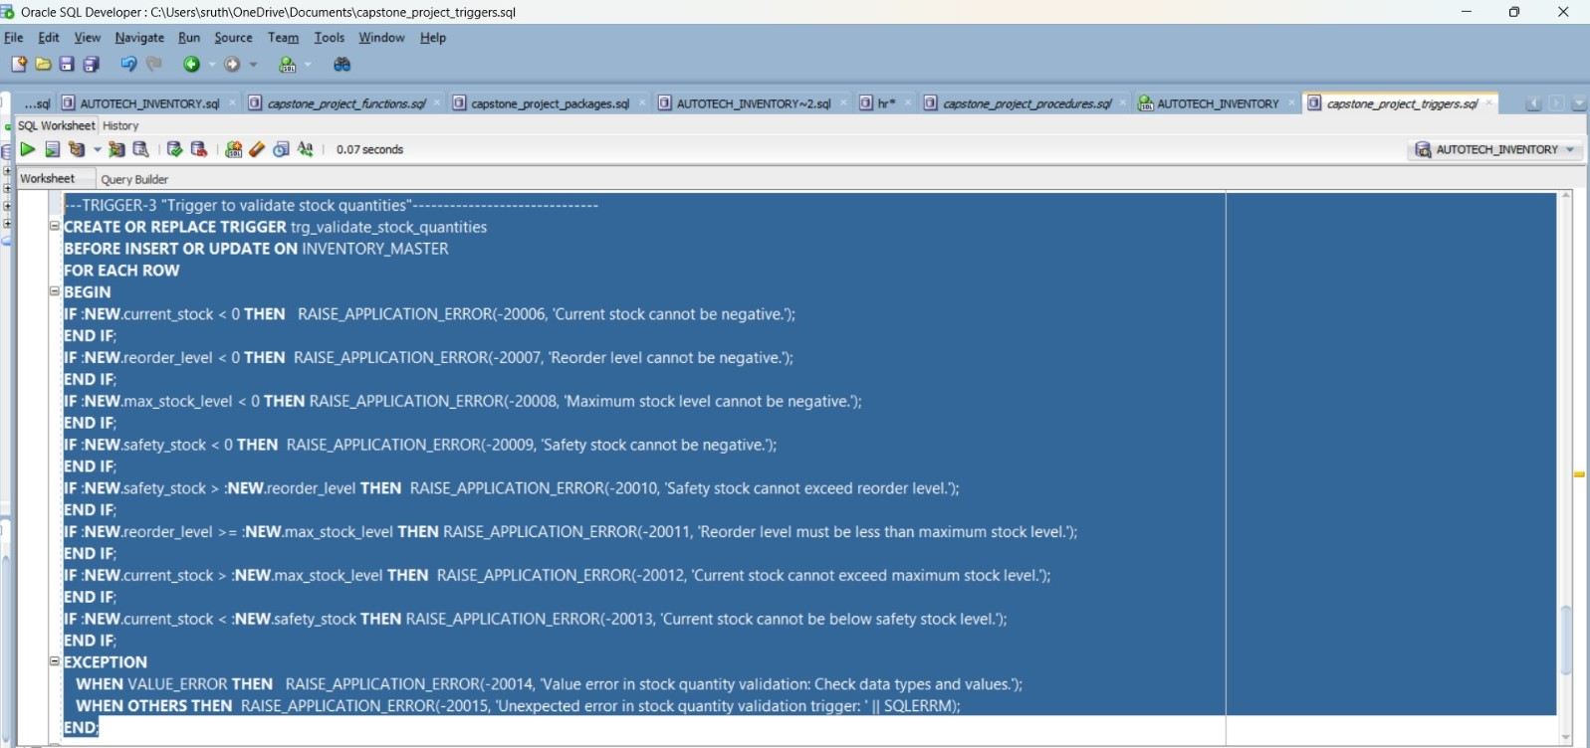
Trigger to Enforce Inventory Business Rules

Slide 16

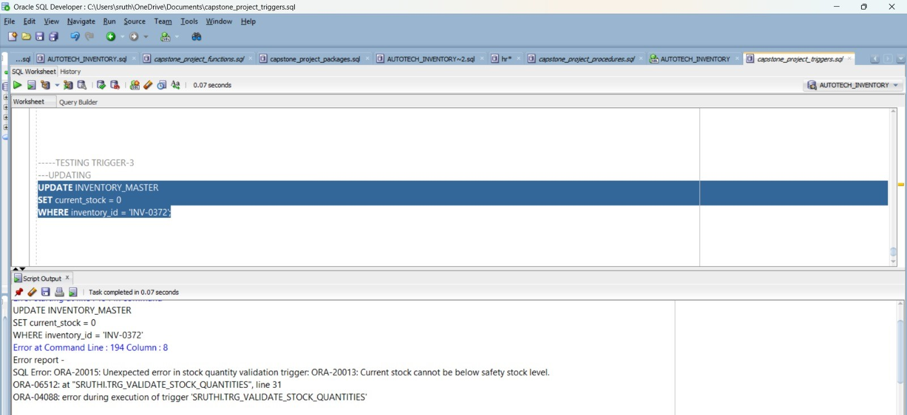
Trigger Testing for Stock Quantity Rules

Slide 17
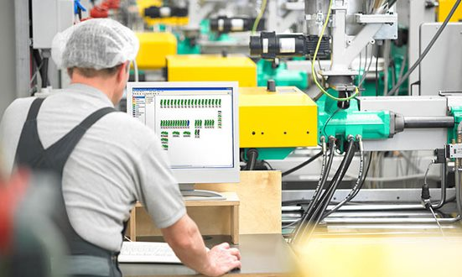
SSIS (SQL Server Integration Services)Purpose:
Extract, Transform, and Load (ETL) data from Oracle DB into reporting systems.
Automates daily processes like stock reconciliation, supplier data imports, and production updates.
Benefits : Ensures smooth and error-free data flow . Cleans and validates data before reporting.
Reduces manual effort and speeds up data preparation.
Guarantees that decision-makers always have fresh and accurate data.

Slide 18

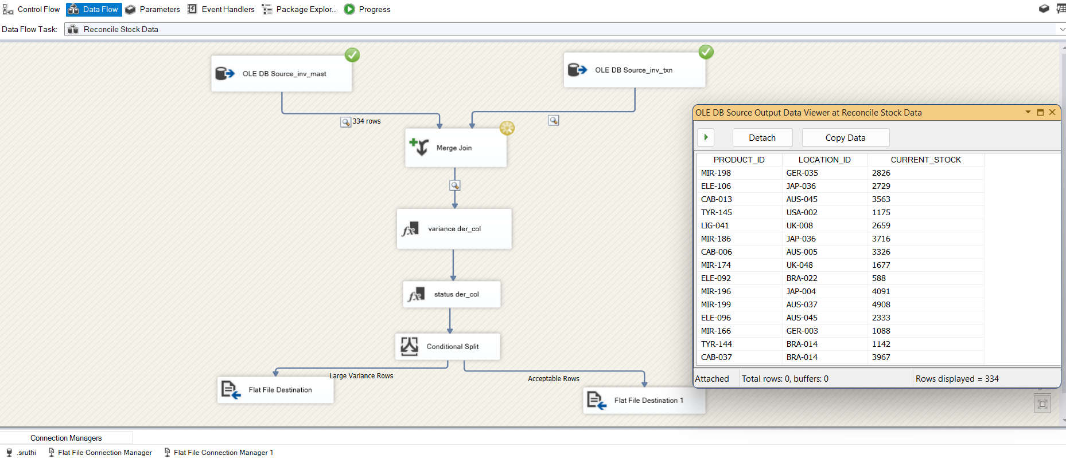
Automated Inventory Reconciliation using SSIS

Slide 19

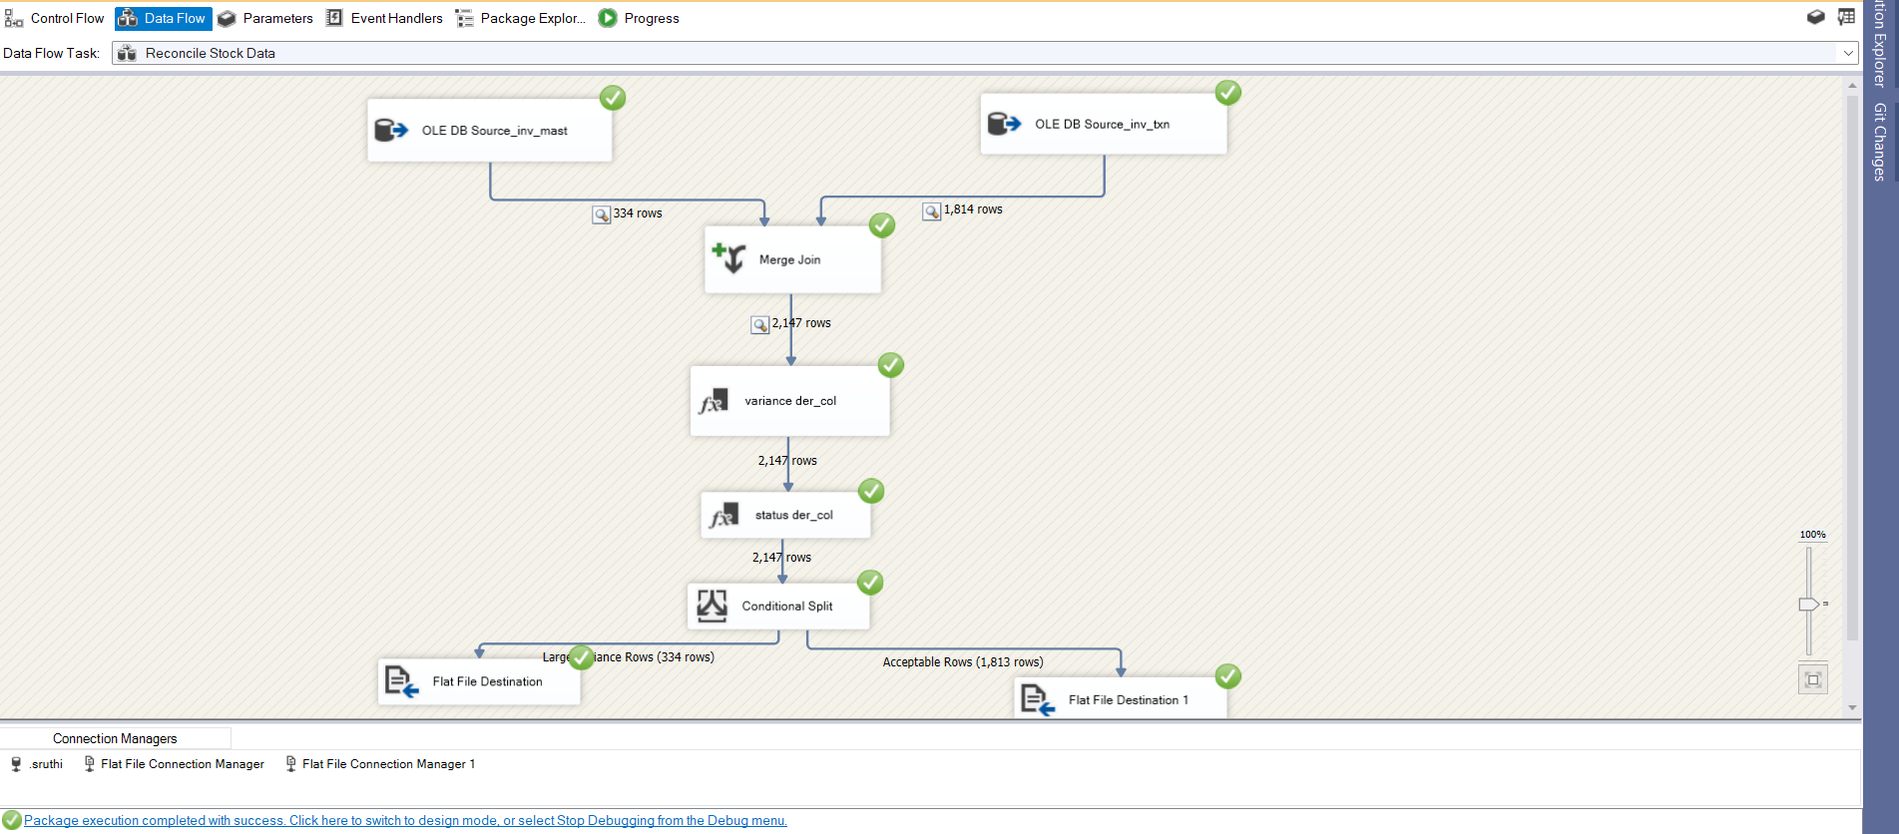
SSIS Workflow: Inventory Variance & Reconciliation

Slide 20
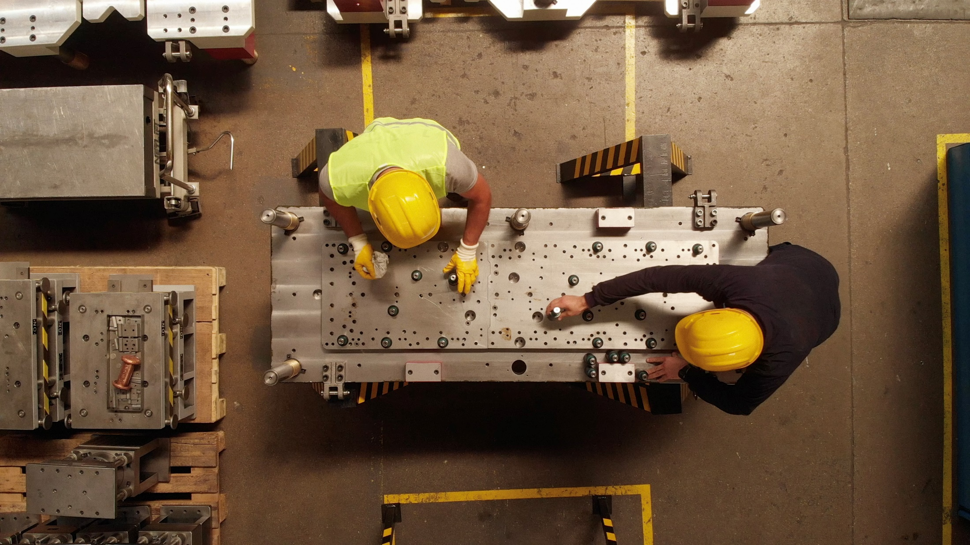
SSRS (SQL Server Reporting Services)Purpose:
Provides detailed operational reports such as Inventory Status, Reorder Alerts, Supplier Performance, and Inventory Aging.
Supports filters, drilldowns, and scheduled email delivery.
Benefits : Gives managers ready-to-use reports every day.
Saves time compared to manual reporting.
Helps in quickly spotting shortages, delays, or excess stock .
Improves day-to-day decision-making.

Slide 21

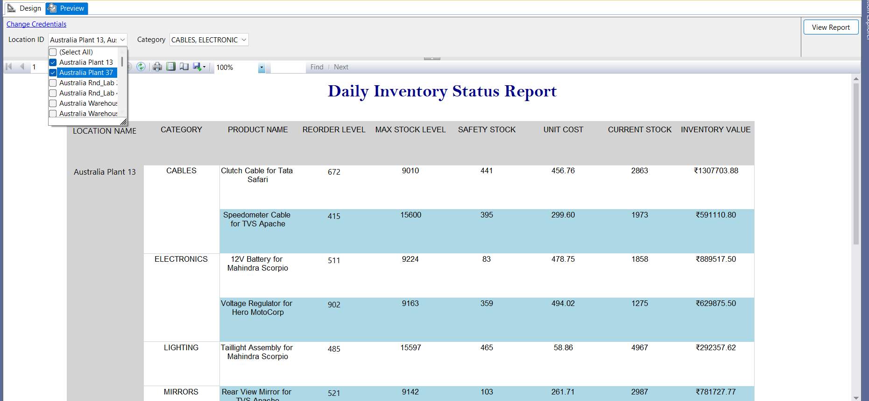
Daily Inventory Status Report using SSRS

Slide 22

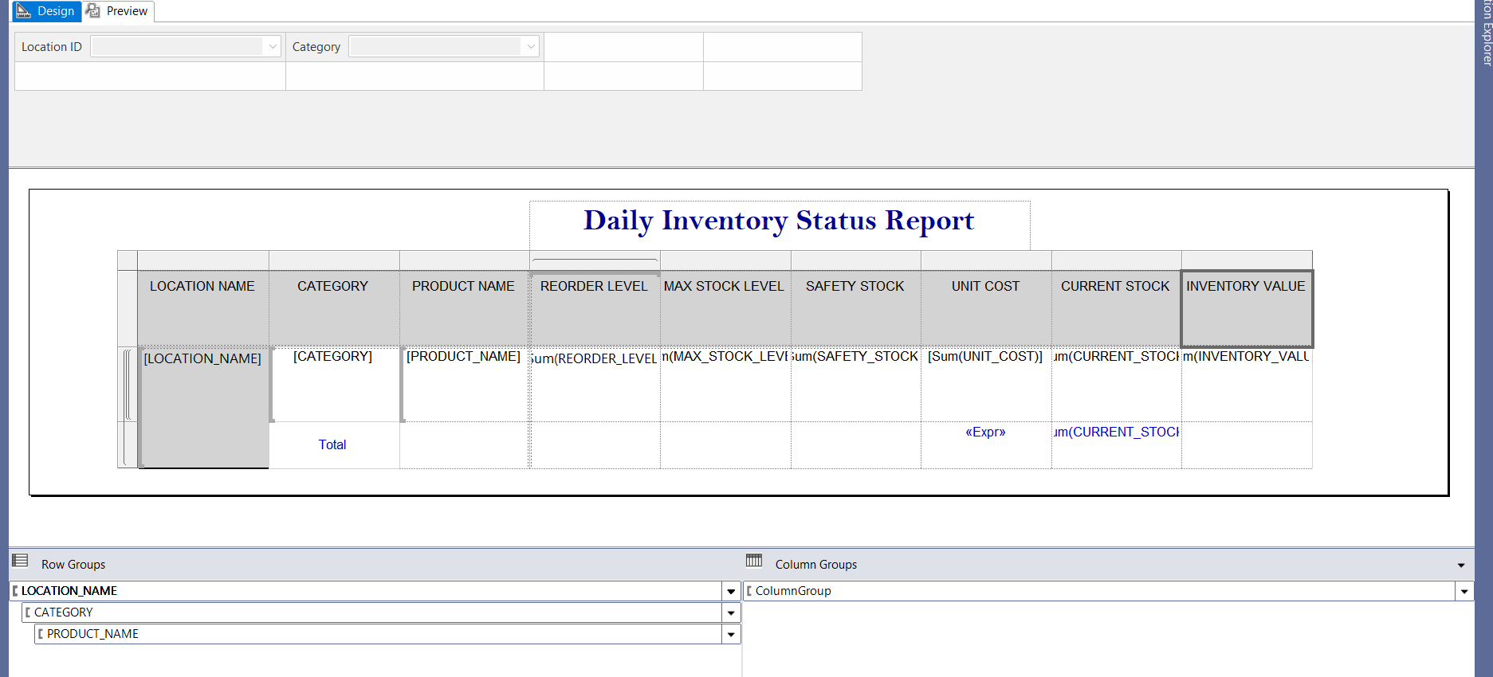
Automated Daily Inventory Report

Slide 23

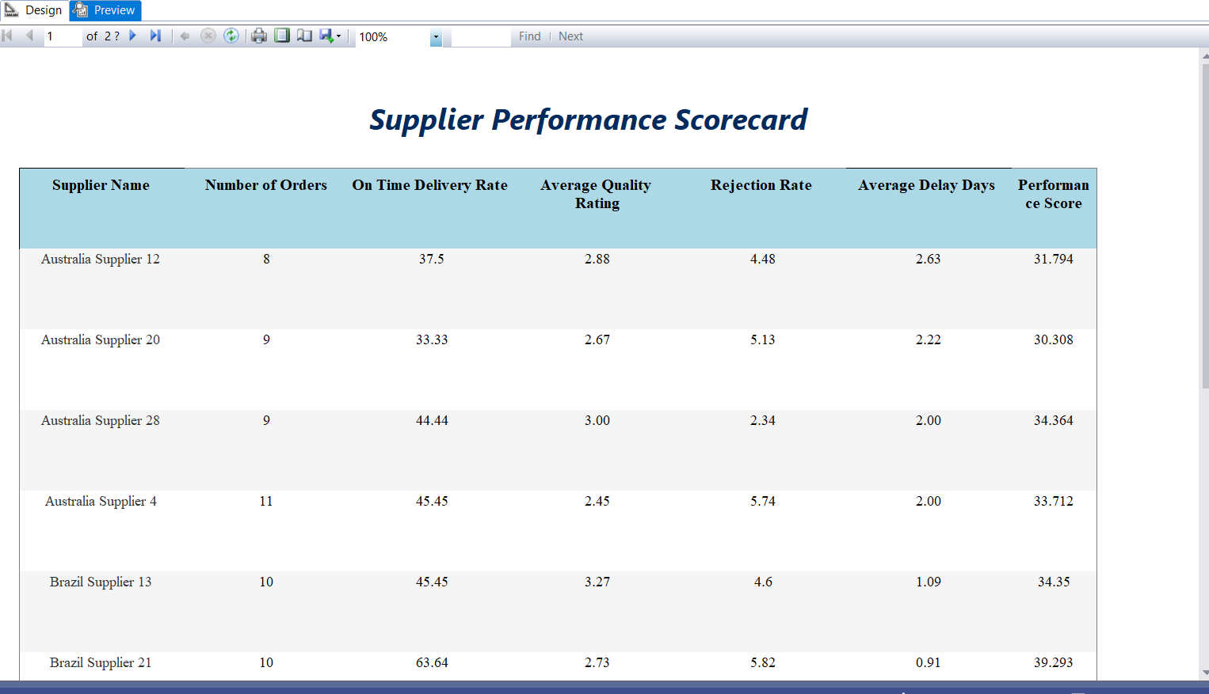
Supplier Performance Scorecard using SSRS

Slide 24
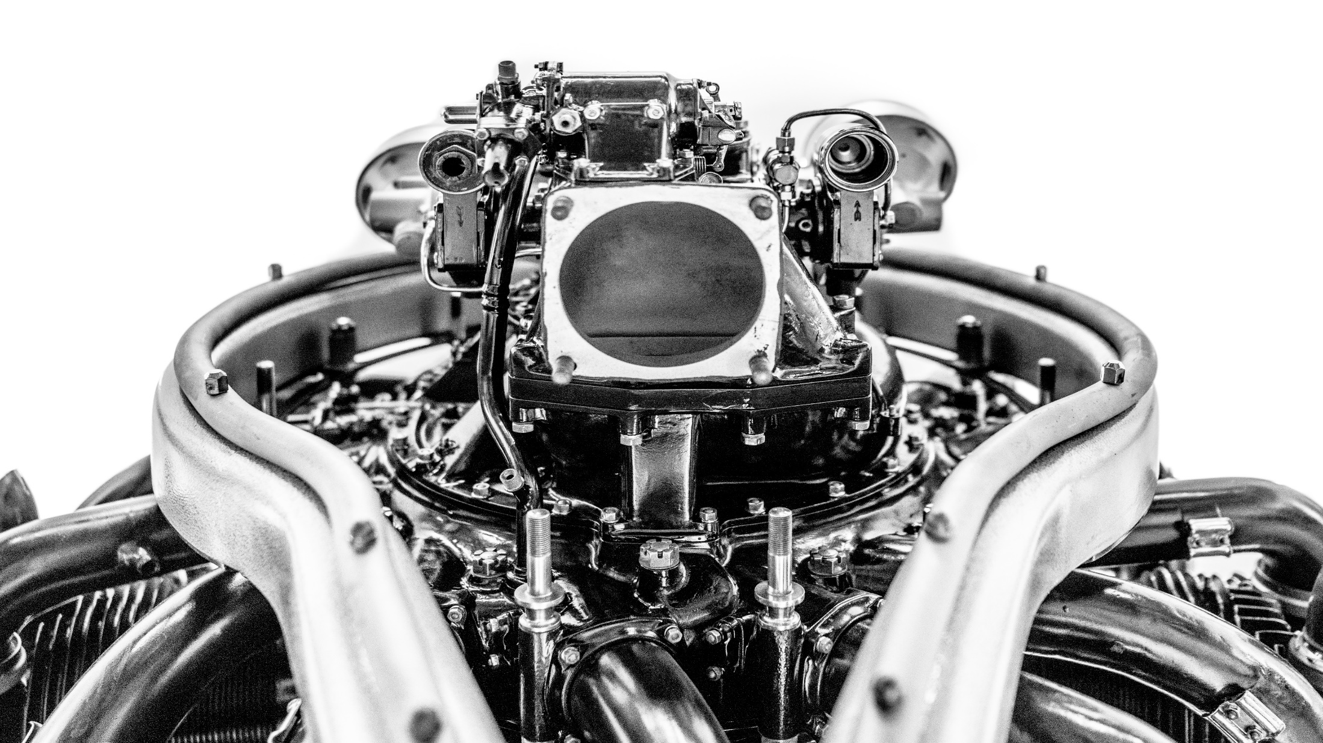
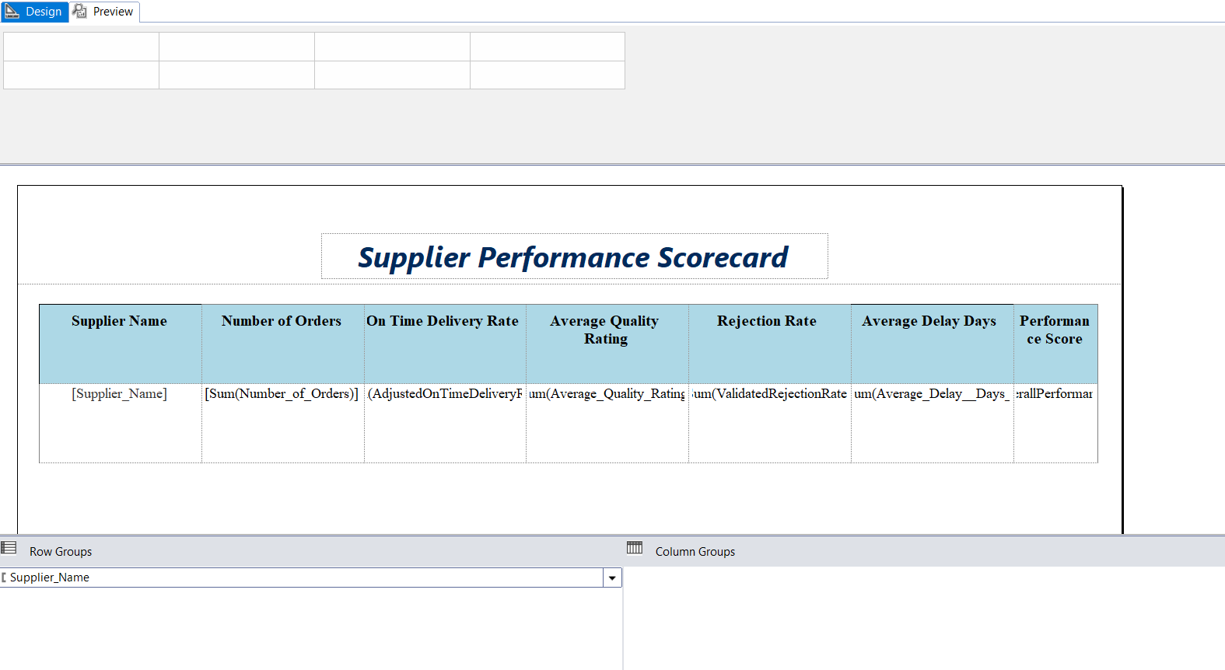
Automated Supplier Scorecard Report

Slide 25

Power BI Purpose:
Builds interactive dashboards for executives and managers.
Combines multiple reports into visual, real-time insights.
Dashboards include Executive KPIs, Plant Operations, Supplier Analytics, and Inventory Optimization.
Benefits : Makes data visual and easy to understand.
Helps leaders see trends and patterns instantly.
Supports forecasting and strategic planning.
Bridges the gap between raw data and business insights.

Slide 26
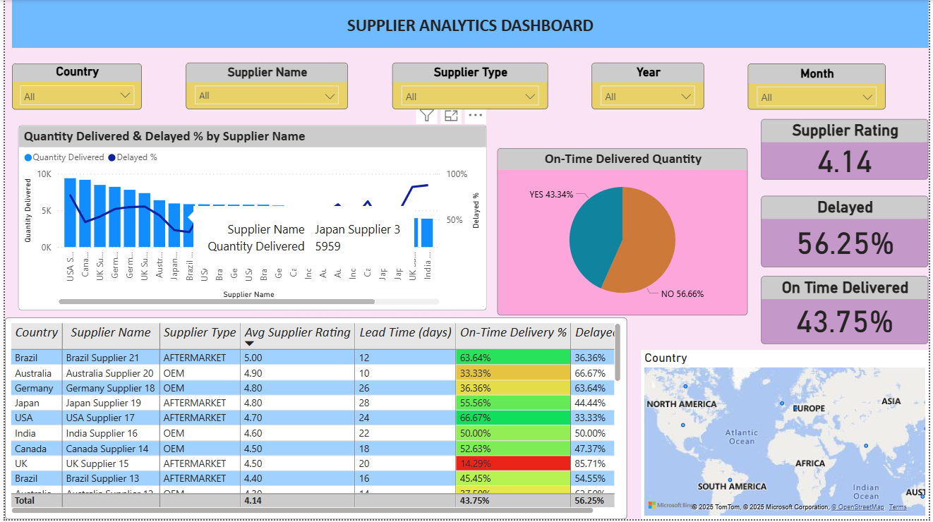
Supplier Analytics Dashboard

Slide 27

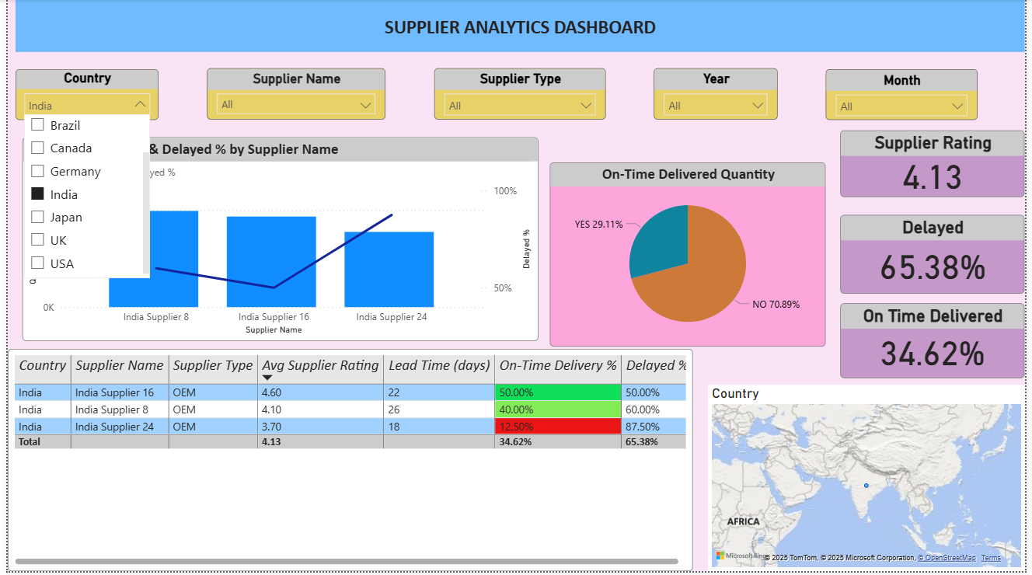
Supplier Analytics Dashboard

Slide 28


proposed solution
The inventory challenge
The Alert System
Tracking Suppliers
Dashboards and Reports

Slide 29
CONCLUSION
The Automotive inventory Management System Successfully integrates database design, SSIS packages, SSRS reports, and Power BI dashboards to solve real industry problems.
It provides real-time visibility of stock, reduces shortages and excess inventory, and supports timely decision-making.
Supplier performance tracking ensures quality and on-time deliveries, strengthening business operations.
Automated processes lower manual effort, improve accuracy, and help in cost optimization.
Overall, this project demonstrates how technology-driven inventory management improves efficiency, reliability, and strategic growth in the automotive industry.

Slide 30

THANK
YOU

